Slide 1
Summer 2025 http://sites.law.lsu.edu/lyonprogram
LSU LAW IN LYON

Slide 2
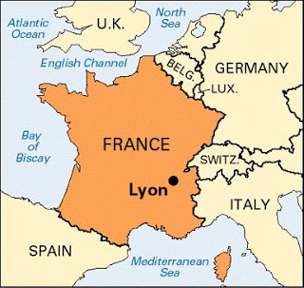
Paris

Slide 3
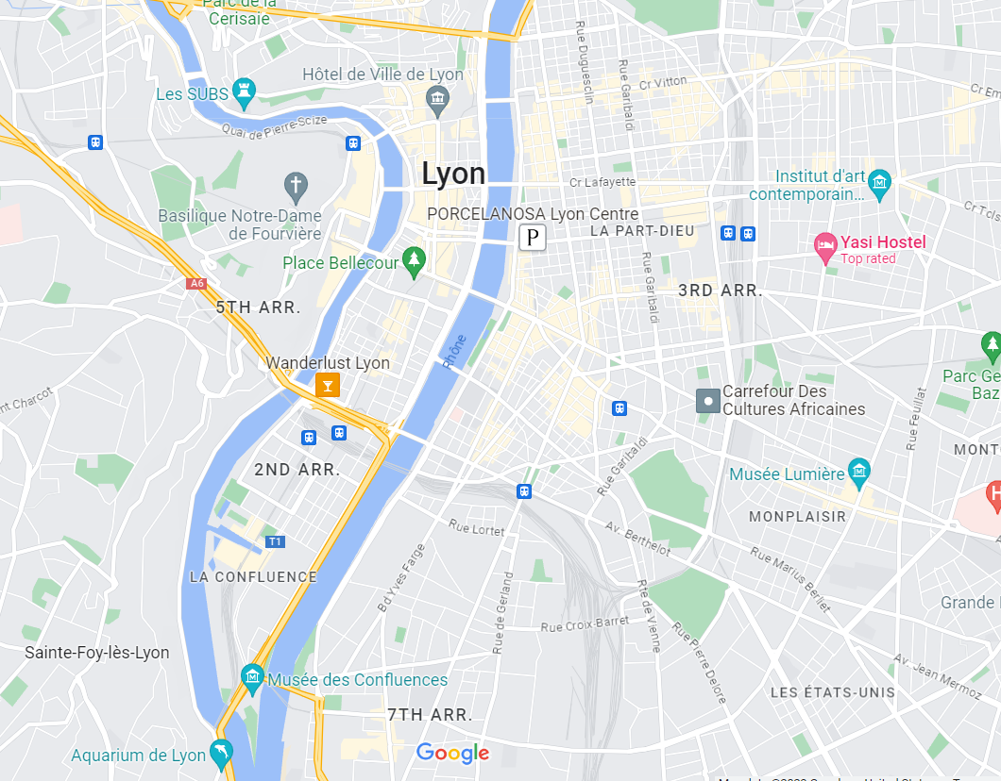

Slide 5
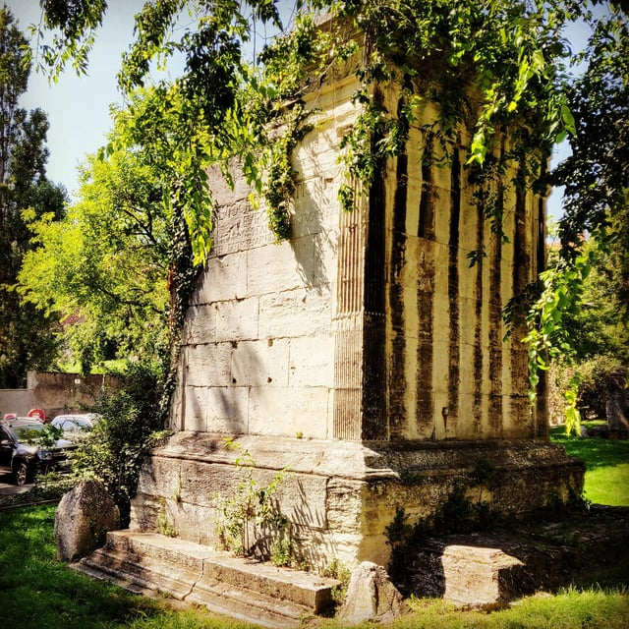
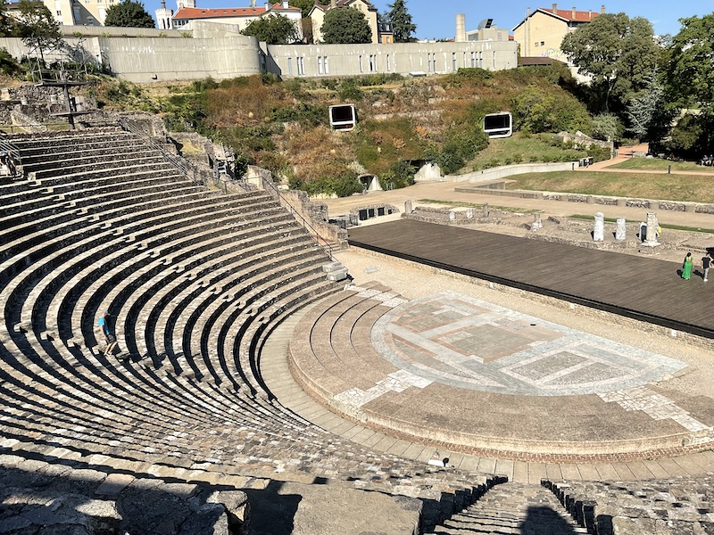
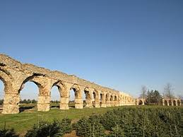
LUGDUNUM,
A Roman City

Slide 6
Vieux Lyon - Old Lyon

Slide 7
Place Bellecour

Slide 8
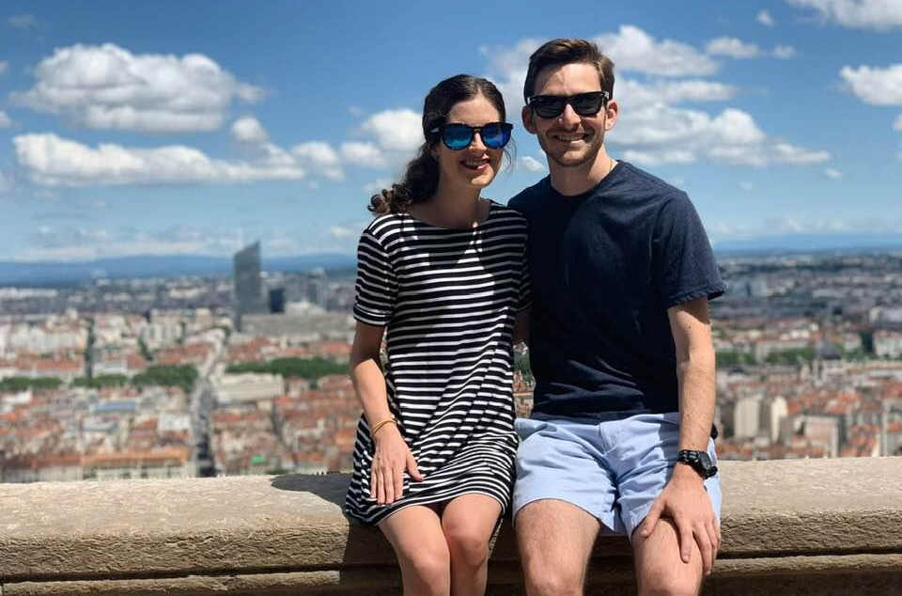
Basilica of Notre-Dame de Fourvière

Slide 10
Budget Estimates
Flight: $1500-$2,000+ (book early!)
Board: $900-
AirBnB generally higher than student housing
Student housing requires additional purchases
Tuition (4 credits):
Resident $4,030
Non-Resident $6,603
Food: $1,000+ -
– Must take into account wine, daily meals, whether you will cook meals (advised), and eating out during weekend excursions (cost of living, and exchange rate to euro differs throughout Europe)
Travel: budget varies, $1,000 - $6,000 (book early!)
– Ex. flight to Barcelona $100, drive to Cannes $30, rent a sailboat $95, train to Interlaken $35, hostel in Pamplona $180, airBNB in Paris $139, flight to Prague $200, etc., Eurail passes $300-400
TOTAL: $6,000-$10,000
– Tuition waivers no longer apply in the summer
– Financial aid may be available

Slide 11
AIRFARE AND TRAVEL RESTRICTIONS
Airfare should cost about $1400-2000 (obviously depends on timing, airline, etc…)
Get your passport yesterday- current wait time is over 1 month
Compare fares to Lyon (via Amsterdam, Frankfort, London or Paris) with fares to Paris plus train to Lyon (non-stop from Paris Airport CDG)
ALL RULES ARE SUBJECT TO CHANGE, AND CHANGE MAY HAPPEN QUICKLY
USE TRAVEL INSURANCE!!!

Slide 12
Financial Aid
Tuition discounts no longer apply
Financial aid/loans may be available
Contact: Heather Kimball
Graduate Coordinator
Enrollment Management
Louisiana State University
1146 Pleasant Hall, Baton Rouge, LA 70803
office 225-578-3103 | fax 225-578-6300
htouch3@lsu.edu | lsu.edu
www.lsu.edu/financialaid

Slide 13
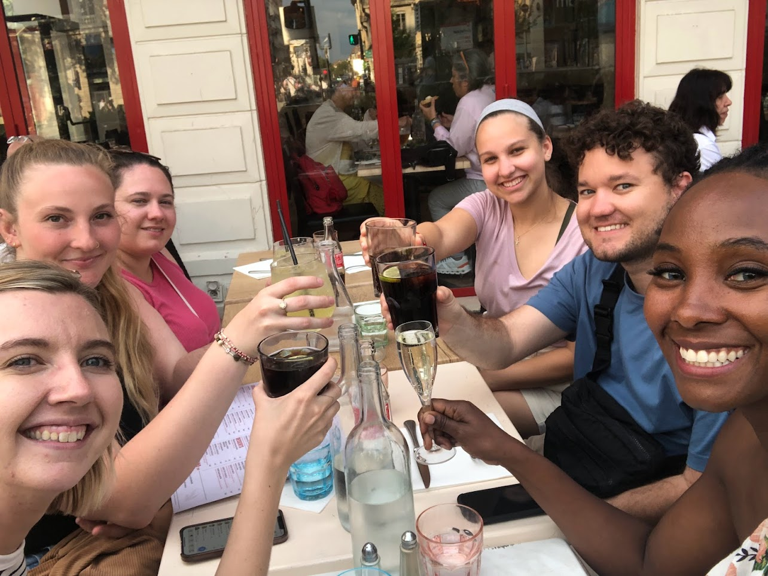
Tuition and Finance - Caveat
All tuition and fees in this PowerPoint are based on numbers from prior years. Final tuition and fee schedule is subject to change.

Slide 14
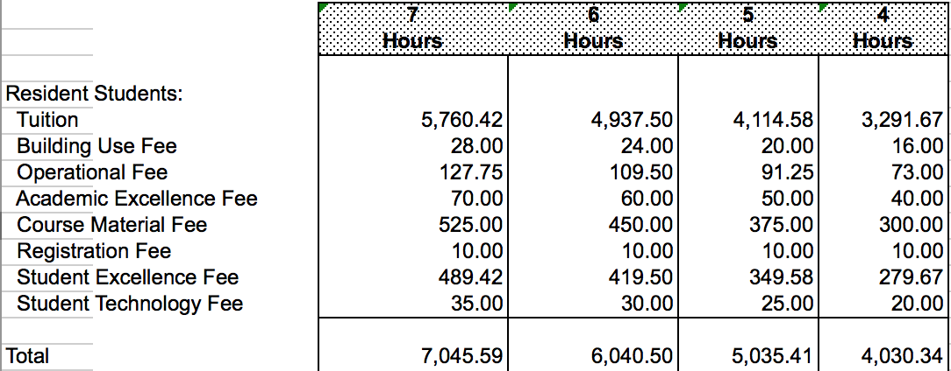
Tuition and Finance - Resident

Slide 15
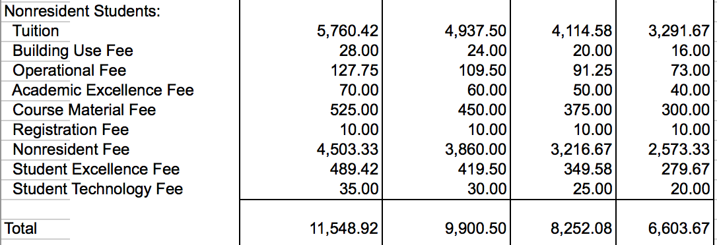
Tuition and Finance - Nonresident

Slide 16
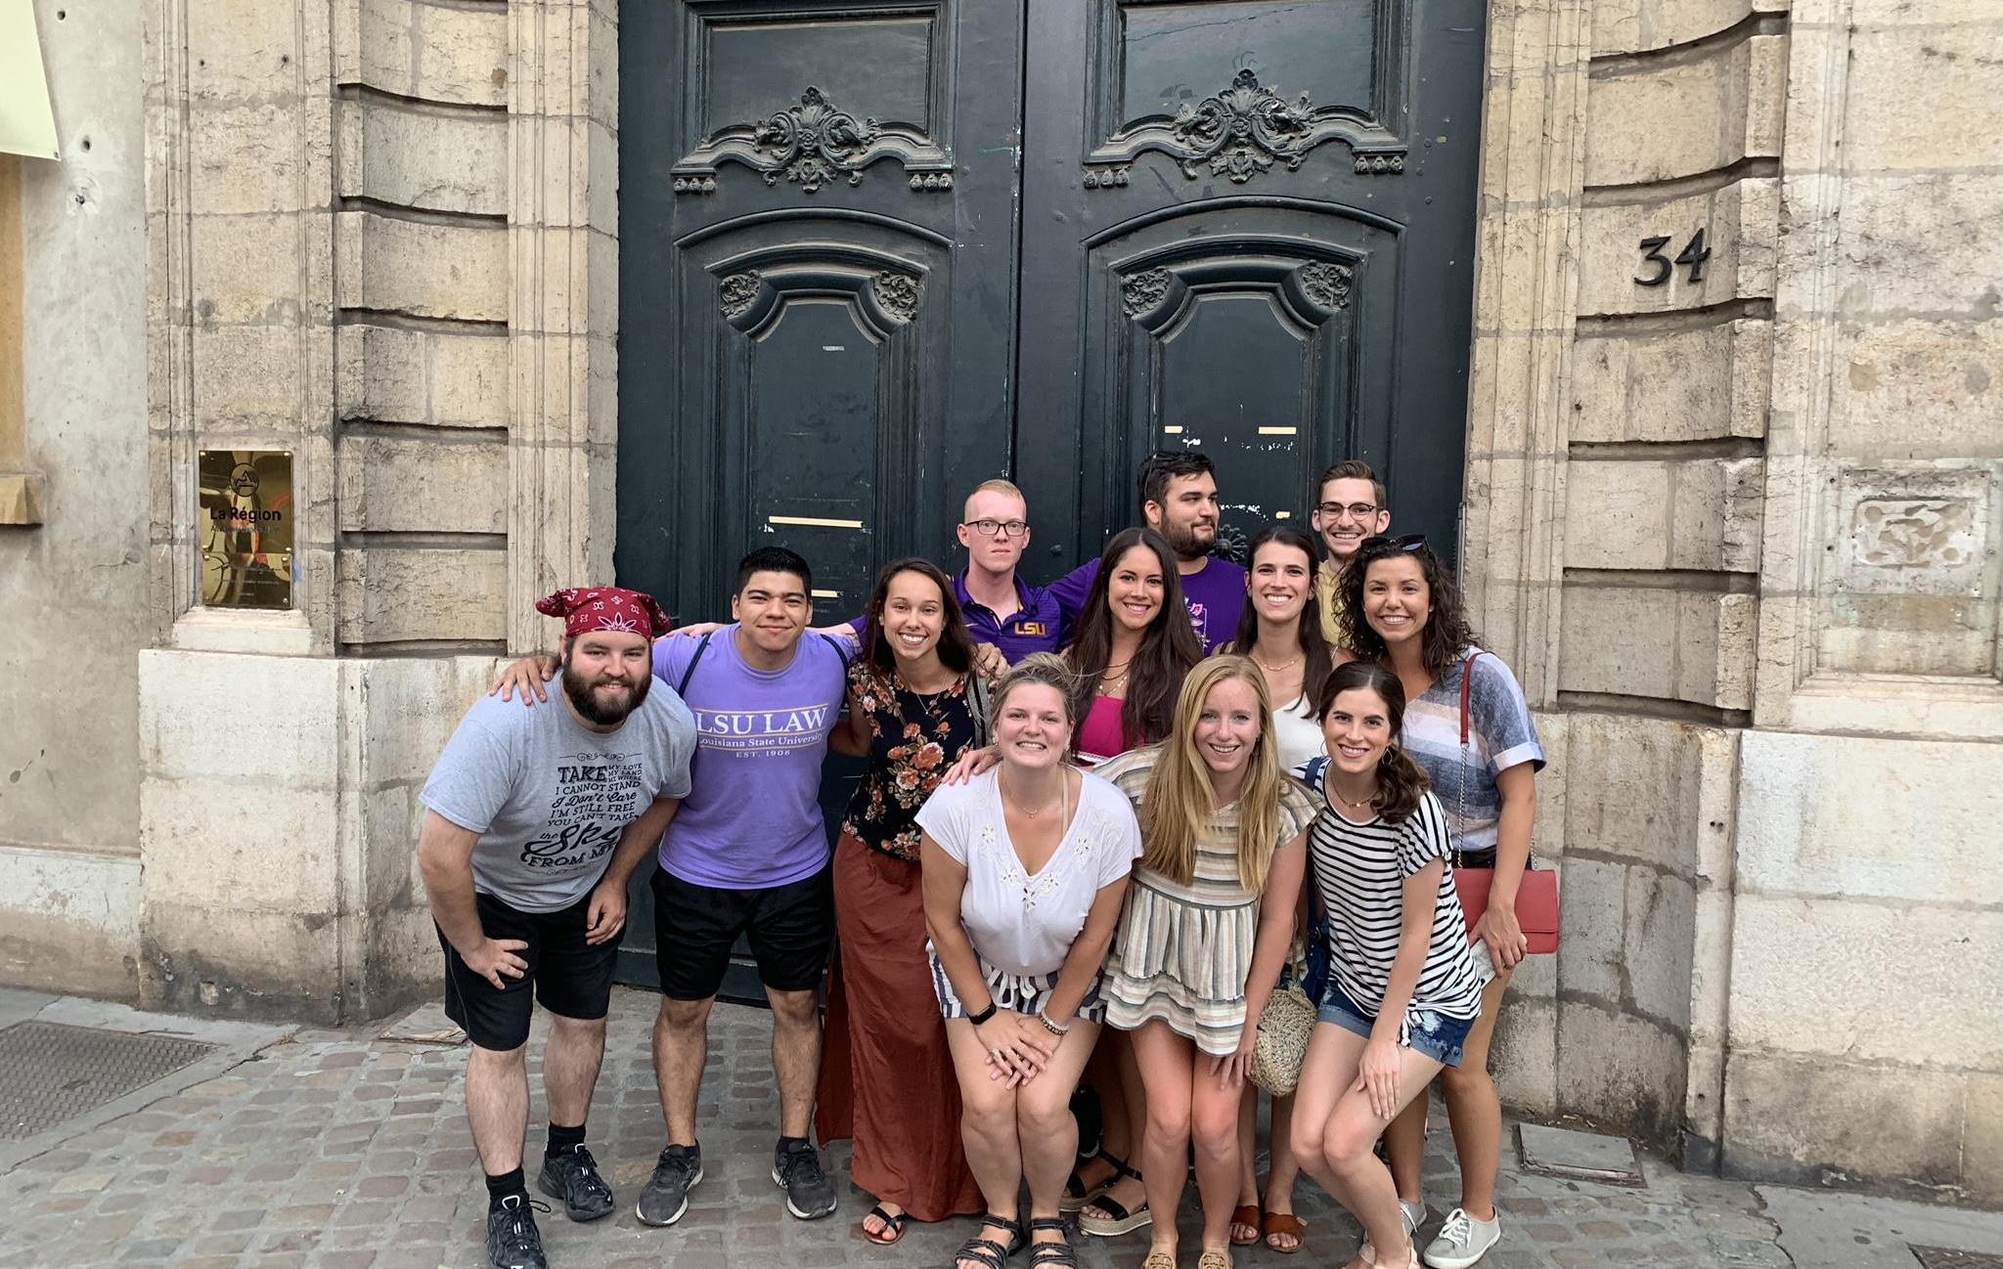
Employment
Summer in Lyon scheduled to allow clerkships
Roughly one-half of past classes clerked
Many Baton Rouge firms schedule summer clerkships to accommodate Summer in France

Slide 17
Housing
Student responsible for own housing
Get housing early, classes end later for Lyon students so housing availability may be limited
Most students use AirBNB, HomeAway or VRBO
Student Housing similar to dorms also available and very close to campus
Talk to Faculty, Students, etc…

Slide 18
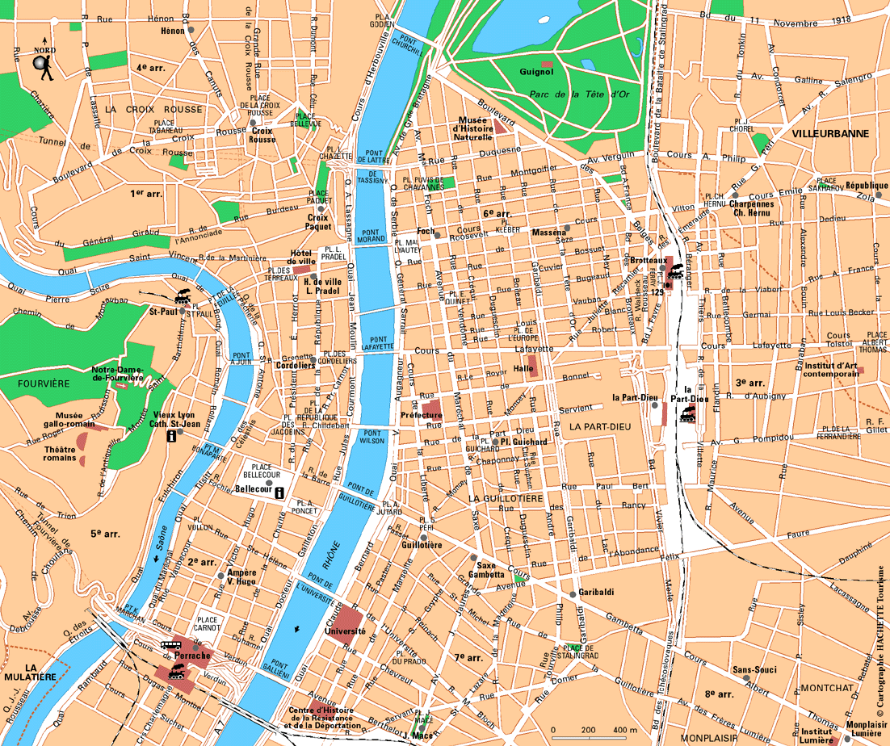

Slide 20
Summer Overview
Dates: June 1 – 20
Class Structure:
4 credits
One 2-credit class
Two 1-credit courses
Scheduled class trips/visits
International Labor Organization (Geneva)
Cour d’appel in Lyon

Slide 21
Course Offering
Human Rights and the Environment (2 credits)
Professor Nicholas Bryner, Paul M. Hebert Law Center, LSU
Comparative Data Protection Law (1 Credit)
Professor Ludovic Pailler, University Jean Moulin, Lyon, France
Comparative Tort Law (1 Credit)
Professor Emeritus Stathis Banakas, University of East Anglia, United Kingdom

Slide 22
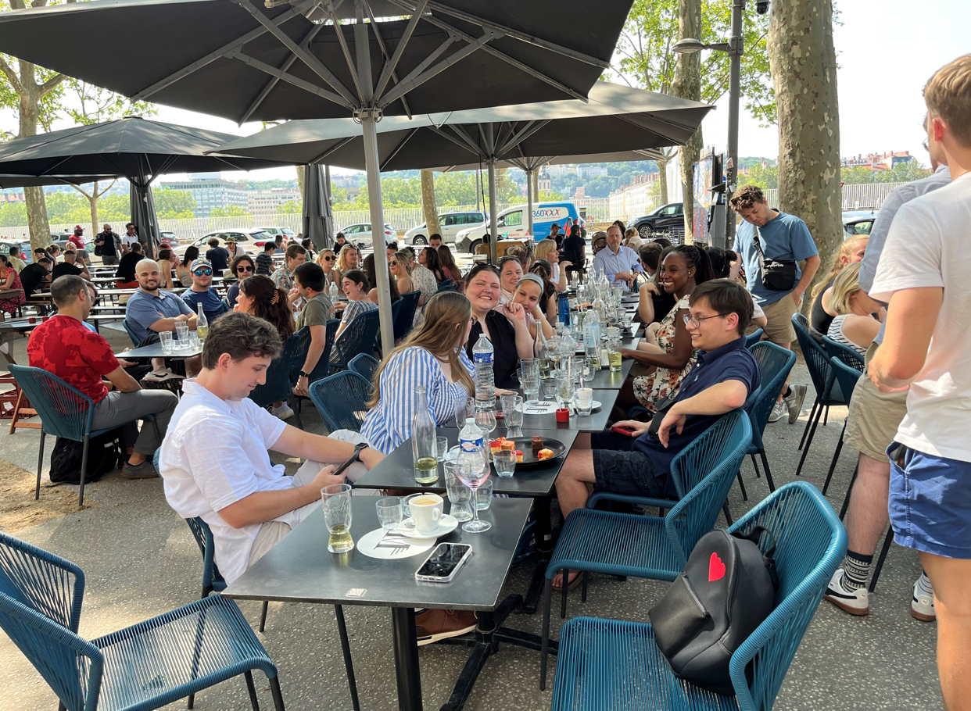
Orientation and Walking Tour of Lyon Before 1st Day of Class

Slide 23
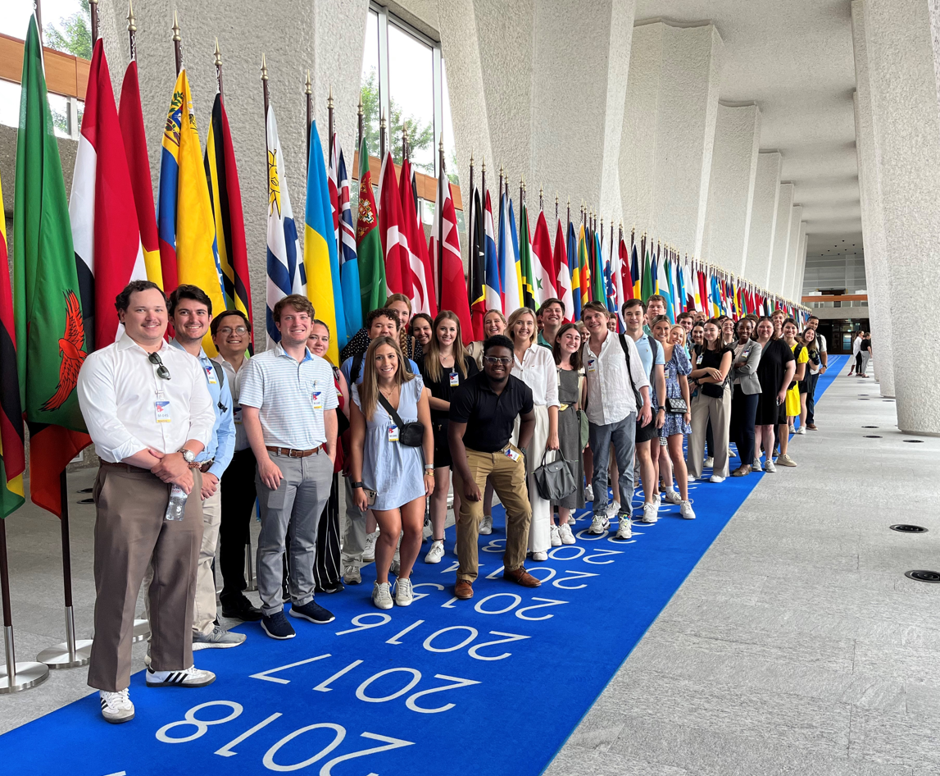
Field Trips
The International Labor Organization in Geneva, Switzerland.

Slide 24
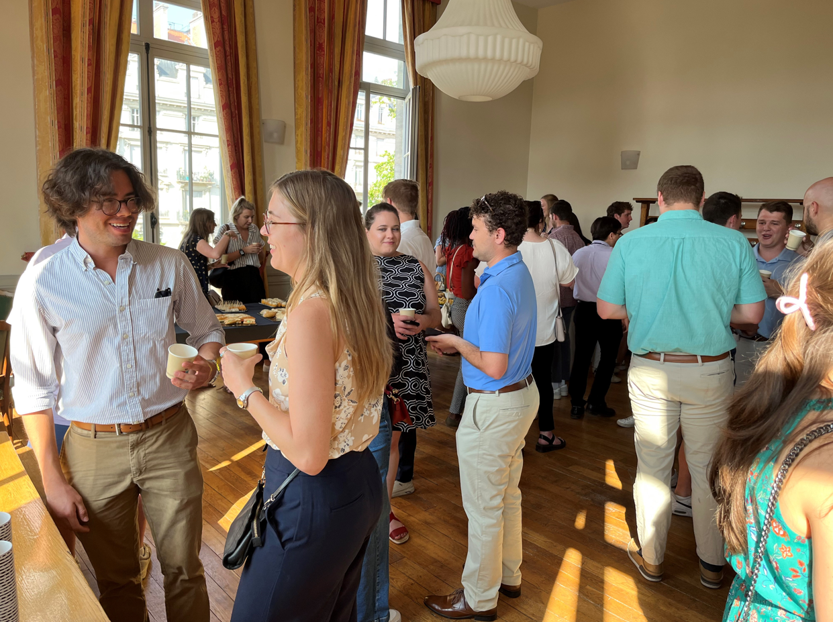
Lyon Dean’s Reception 1st Week

Slide 25
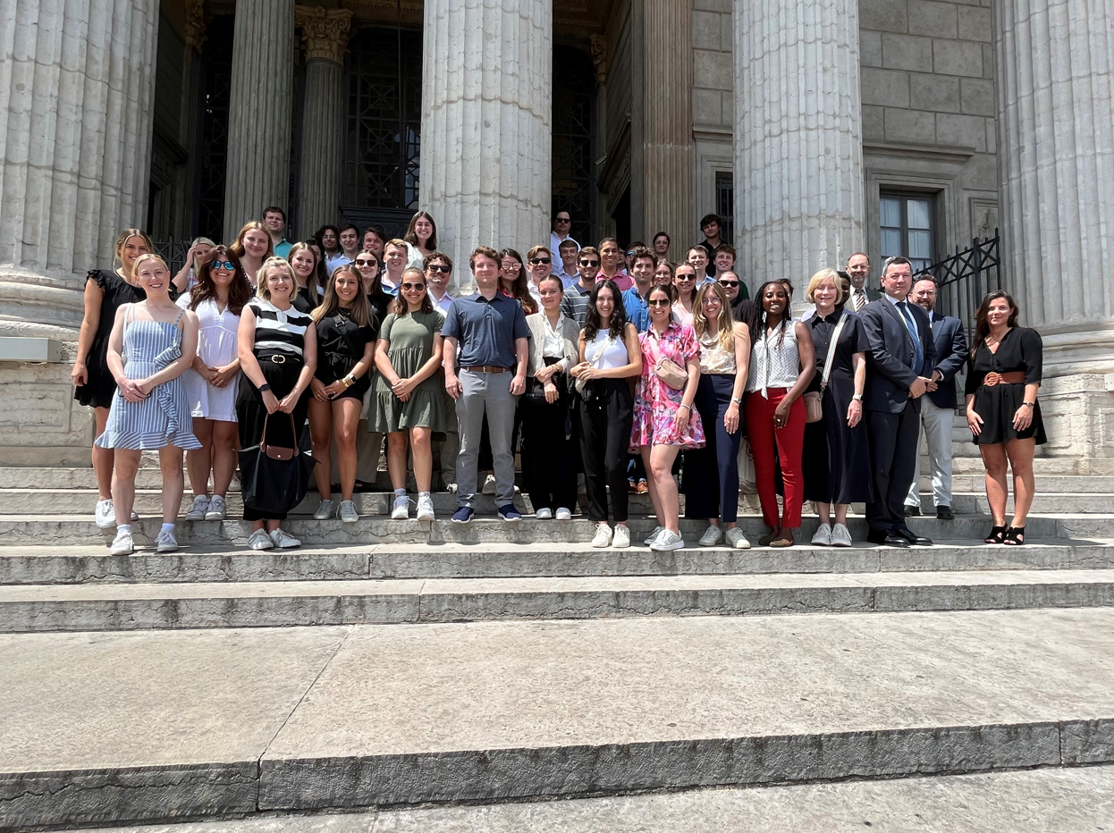
Historic Court of Appeals

Slide 26
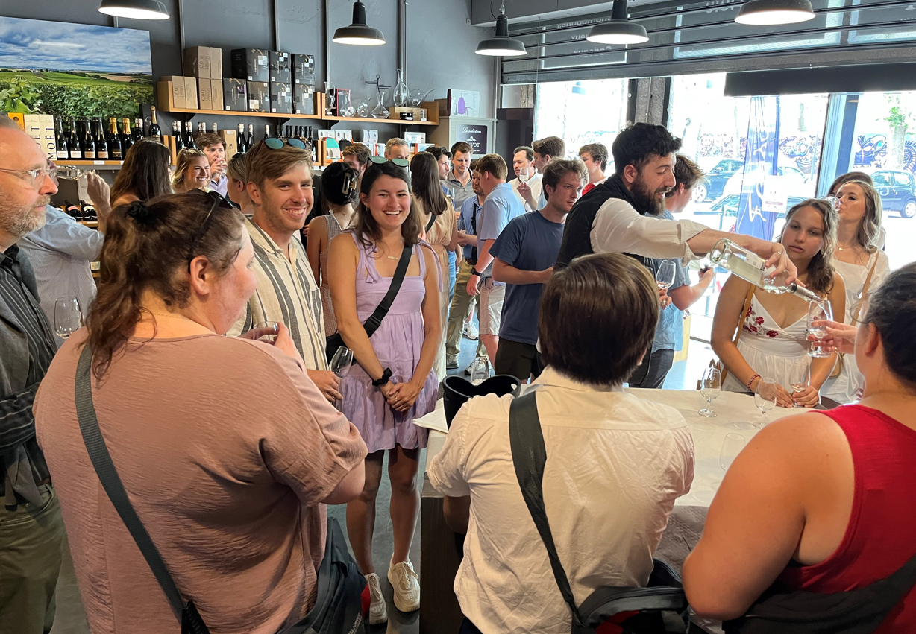
Wine Tasting

Slide 27
Voyages de weekend

Slide 28
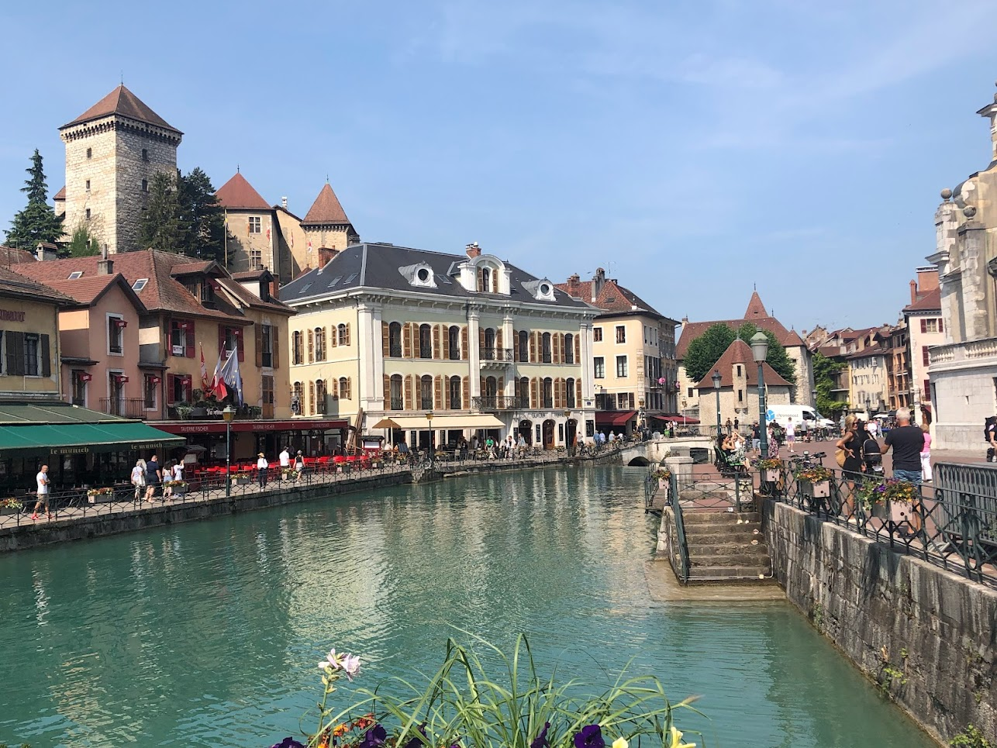
Annecy, France

Slide 29
Avignon, France

Slide 30
Student Testimonial
Lyon est magnifique!! J'ai adoré la ville et j'ai hâte d'y retourner.
(Lyon is magnificent!! I loved the city and can’t wait to return.) The culture, the people, the FOOD!!! It was an amazing opportunity to explore another country while also getting to know students from different sections that I hadn’t spoken with or met before. We made bonds that will last for the rest of our lives and memories we won’t soon forget. The class offerings and scheduling allowed time to adventure across Europe while learning and thoroughly digesting the information. My only complaint is that the program isn’t longer. 10/10 would definitely do it again.
- Daniellepatrice Payne

Slide 31
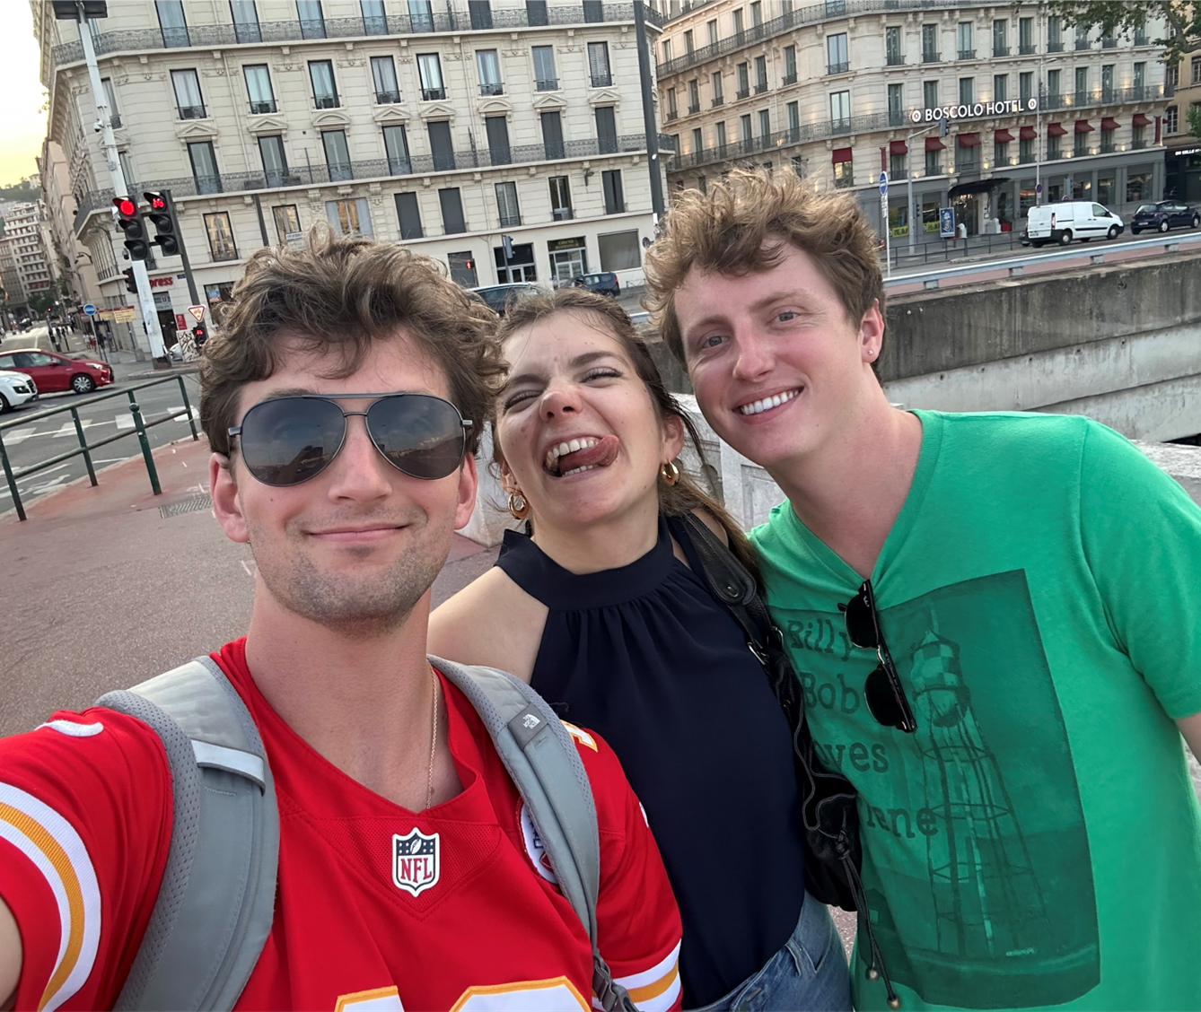
Student Testimonial
“Studying abroad in Lyon has been the highlight of my time in law school thus far. Being submerged in European culture for six weeks was an eye-opening experience and one I highly recommend. Traveling to different countries with friends and making lasting memories, what more could you want. Also, you have not truly lived until you have had French pastries. It will make your mother’s baked goods taste like ash. -Ben Jester
My friend Chris and I with a local French icon

Slide 32
Contacts
Professor Nicholas Bryner (bryner@lsu.edu)
Professor Olivier Moreteau (moreteau@lsu.edu)
Professor John Church (jchurch@lsu.edu)

