Slide 1
June 14 – July 24, 2020 http://sites.law.lsu.edu/lyonprogram
LSU LAW IN LYON

Slide 2
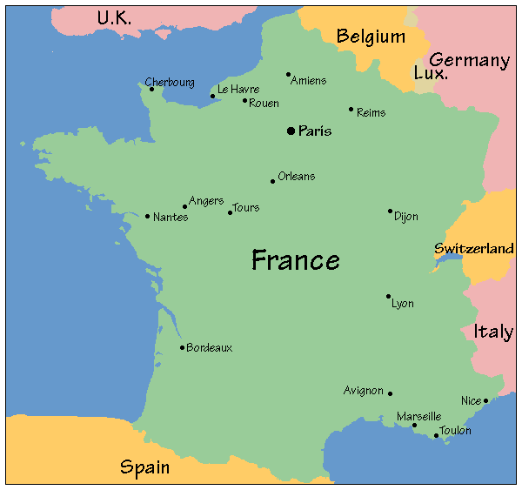

Slide 5
PLACE BELLECOUR

Slide 6
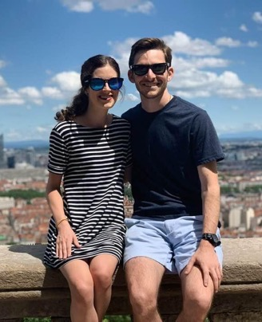
BASILICA OF NOTRE-DAME DE FOURVIÈRE

Slide 8
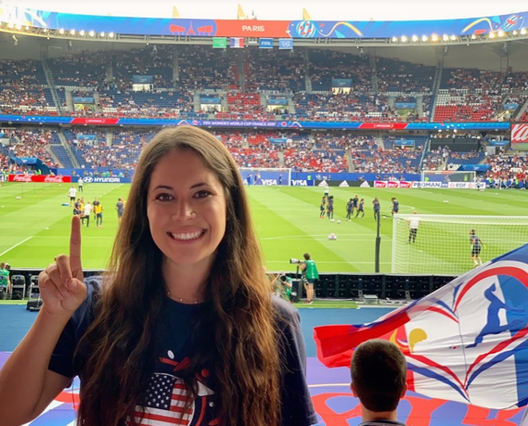

Slide 9
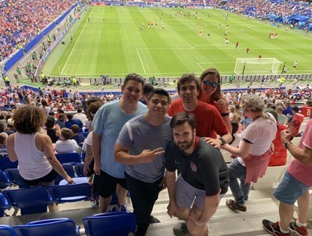
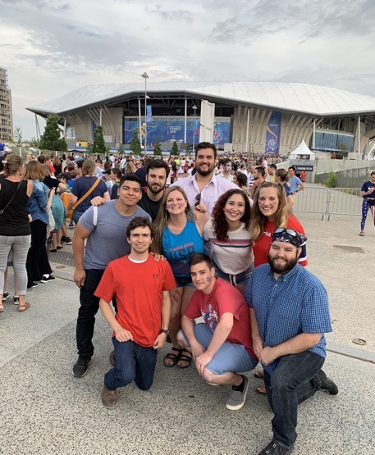
PARC OLYMPIQUE LYONNAISE

Slide 10
BUDGET ESTIMATES
Flight: $900-$1500 (book early!)
Board: $600-$900
Tuition:
Resident $4,030-$7,045
Non-Resident $6,603-$11,548 (4-7 credits)
Food:
Travel: budget varies, $1,000 - $10,000
– Ex. flight to Barcelona $100, drive to Cannes $30, rent a sailboat $95, train to Interlaken $35, hostel in Pamplona $180, airBNB in Paris $139, flight to Prague $200, etc., Eurail passes $300-400
TOTAL: $6,000-$14,000
– *Tuition Scholarships May Apply
– Financial Aid If Eligible

Slide 11
FINANCIAL AID
Tuition Discounts Apply
Financial Aid/Loans Available (Spread Over Three Semesters)
Contact: Heather Kimball
Graduate Coordinator
Enrollment Management
Louisiana State University
1146 Pleasant Hall,
Baton Rouge, LA 70803
office 225-578-3103
fax 225-578-6300
htouch3@lsu.edu www.lsu.edu/financialaid

Slide 12
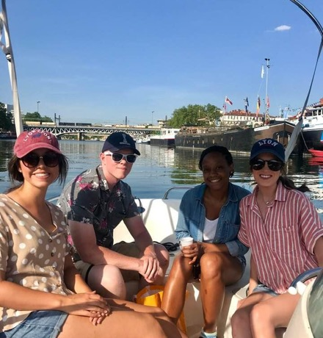
TUITION AND FINANCE: A CAVEAT
All tuition and fees in this PowerPoint are based on numbers from the 2019 summer program as we have them today. Final tuition and fee schedule is subject to change.

Slide 13
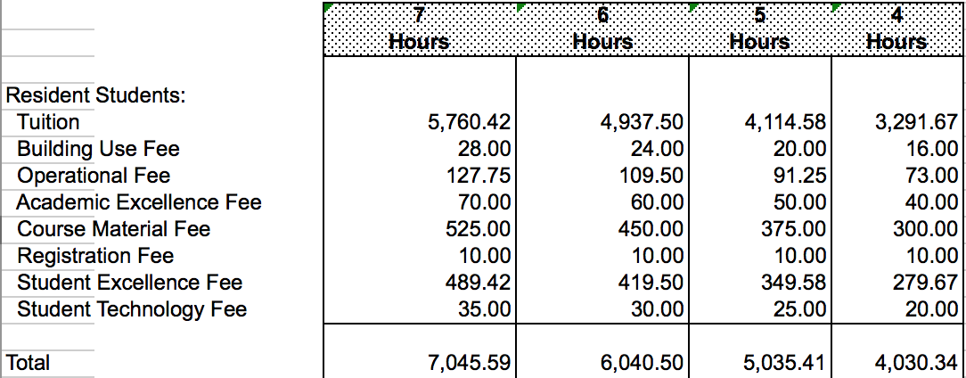
TUITION AND FINANCE - RESIDENT

Slide 14
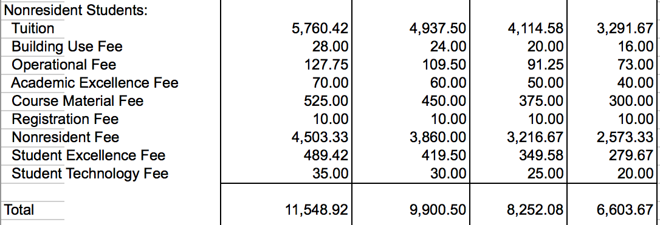
TUITION AND FINANCE - NONRESIDENT

Slide 15
TUITION DISCOUNTING–
NONRESIDENT EXAMPLE
TUITION DISCOUNTING-
RESIDENT EXAMPLE
Resident Student
– Receives a $17000 (86%) academic year tuition discount
– Student takes five (5) hours in Lyon
$576.04 in tuition
$920.83 Fees
Total = $1,496.87
Nonresident Student
– Receives a $5000 (25%) academic year tuition discount
– 4 credit hours in Lyon
$2468.75 Tuition
$2573.33 Nonresident Fee
$738.67 Additional Fees
Total = $5,780.75

Slide 16
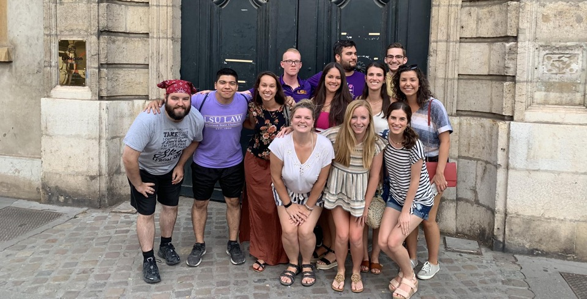
EMPLOYMENT
Summer in Lyon scheduled to allow clerkships
Roughly one-half of last class clerked
Many Baton Rouge firms schedule summer clerkships to accommodate Summer in France

Slide 17
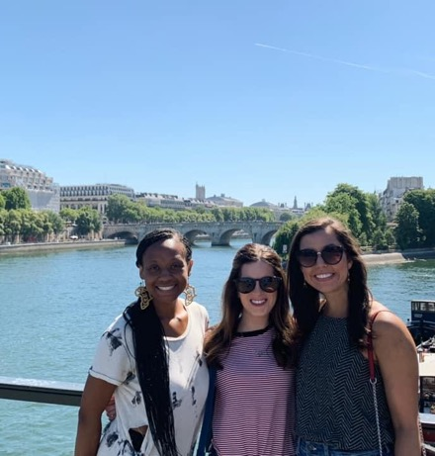
HOUSING
Students are responsible for own housing
Most students use AirBNB, HomeAway or VRBO
Talk to Faculty, Students, etc…
Assistants—Katelyn Bayhi (kbayhi2@lsu.edu) or Kate McLean (kmclea4@lsu.edu)

Slide 18
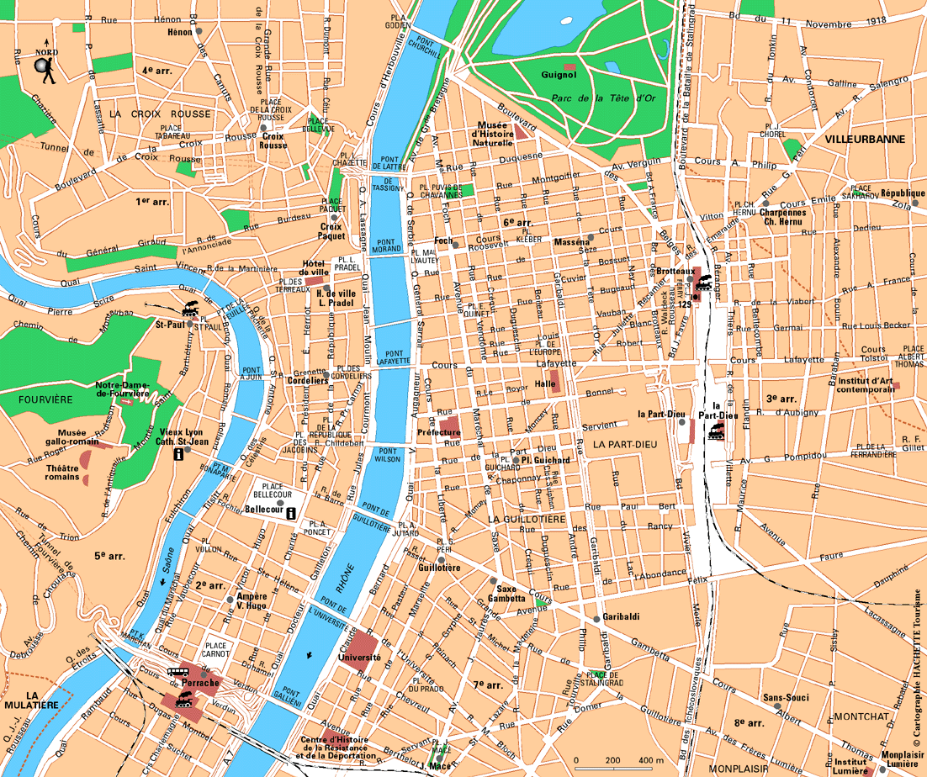

Slide 19
SUMMER OVERVIEW
Class Structure:
– 4-7 credits (two 3-week “semesters”)
– Two 1-credit courses offered each semester
– One 3 –credit class that lasts six weeks

Slide 20
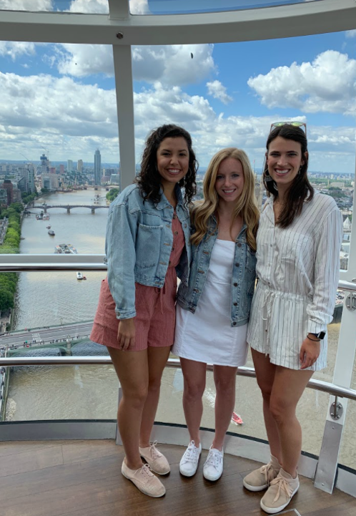
PREVIOUS COURSE OFFERINGS
Comparative Sales Law
Comparative Competition Law
Comparative Criminal Justice
Comparative Legal Ethics and Professionalism
Harmonizing the Law Across National Borders
Comparative Family Law
International Comparative Maritime Personal Injury
Comparative Torts
Comparative International Law
International Art Law
Comparative Tax Law
Comparative Civil Procedure

Slide 21
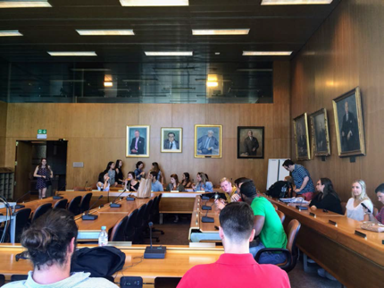
FIELD TRIPS
The International Labor Organization in Geneva, Switzerland.

Slide 22
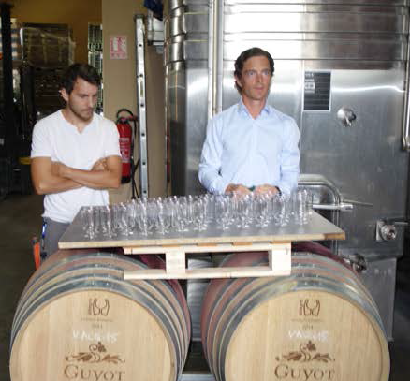
VINEYARDS AND WINE TASTING

Slide 23
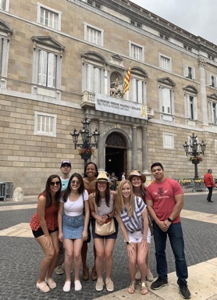
LSU Law Lyon: Class of 2019

Slide 24
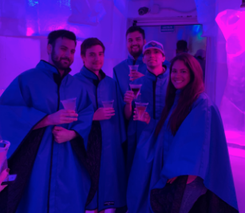
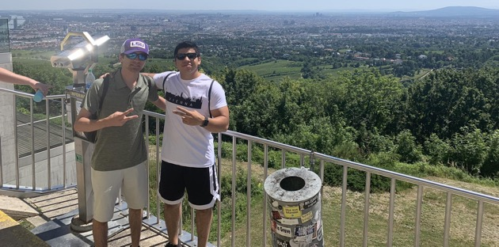

Slide 25
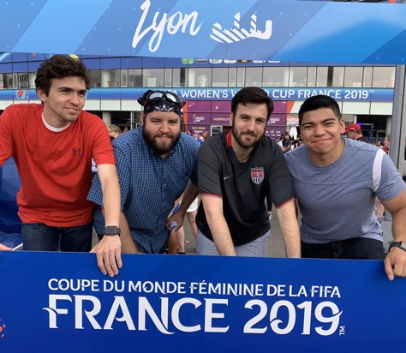
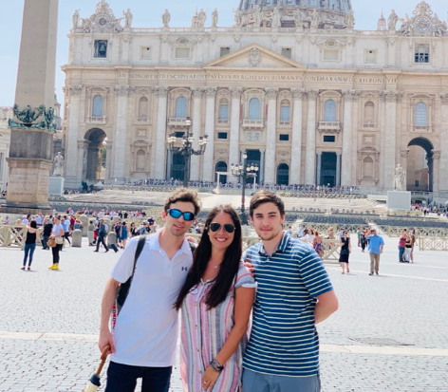
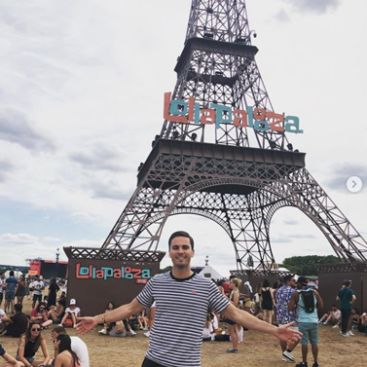
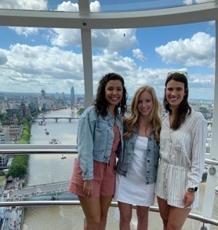
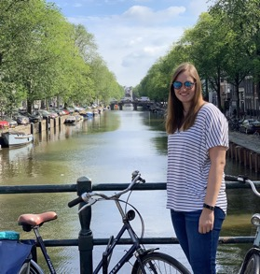

Slide 26
VOYAGES DE WEEKEND

Slide 27
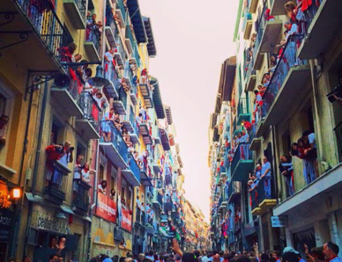
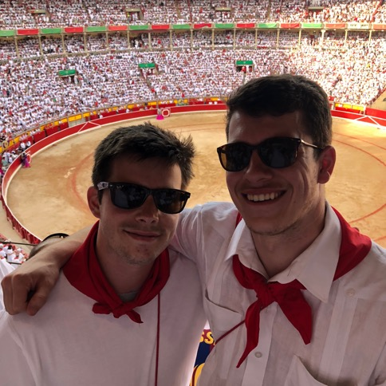
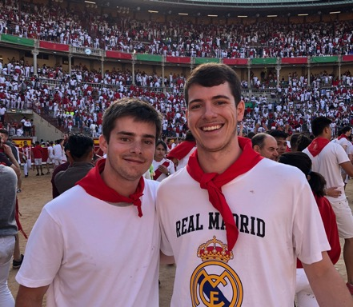
PAMPLONA
Running of the Bulls

Slide 28
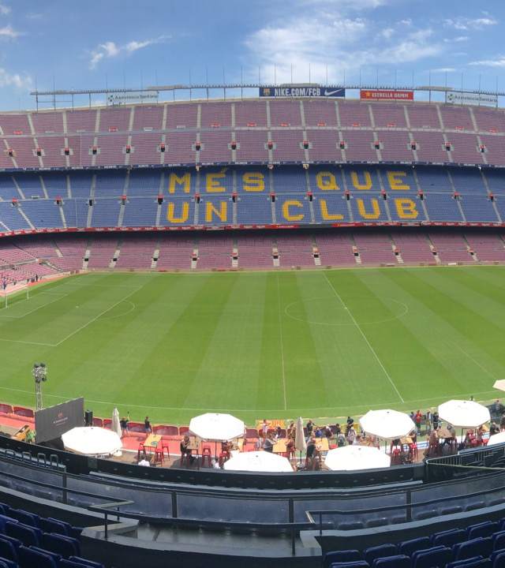
BARCELONA

Slide 29
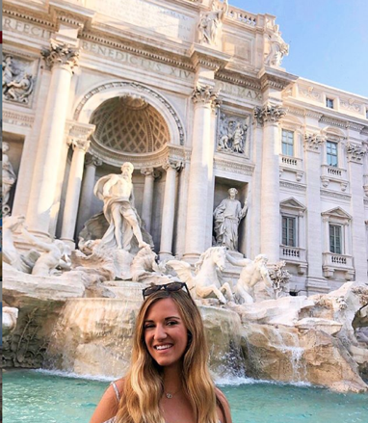
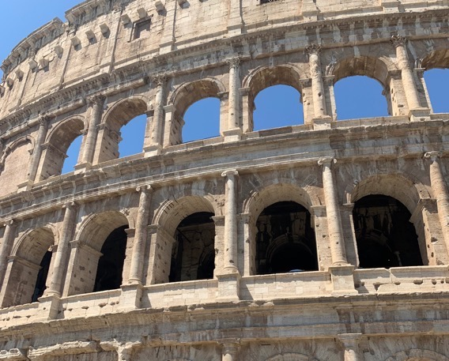
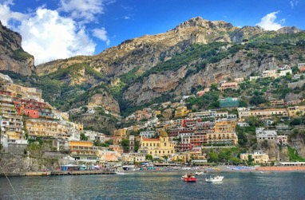
ITALY

Slide 30
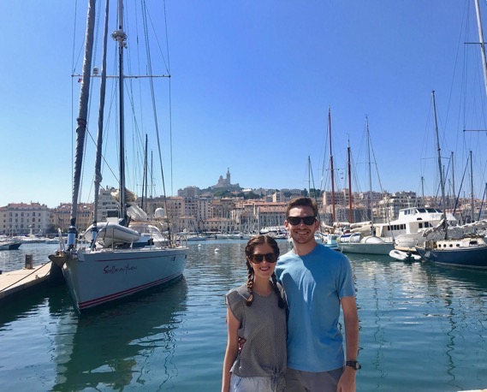
MARSEILLE, FRANCE

Slide 31
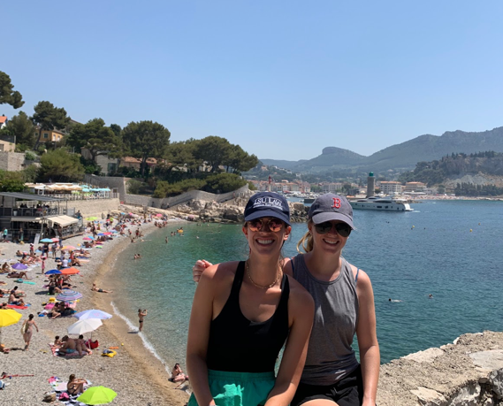
CASSIS, FRANCE

Slide 32
INTERLAKEN,SWITZERLAND

Slide 33
SWITZERLAND

Slide 34
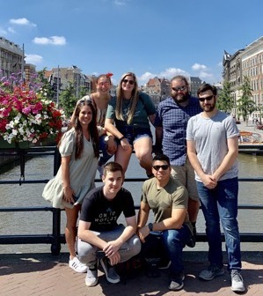
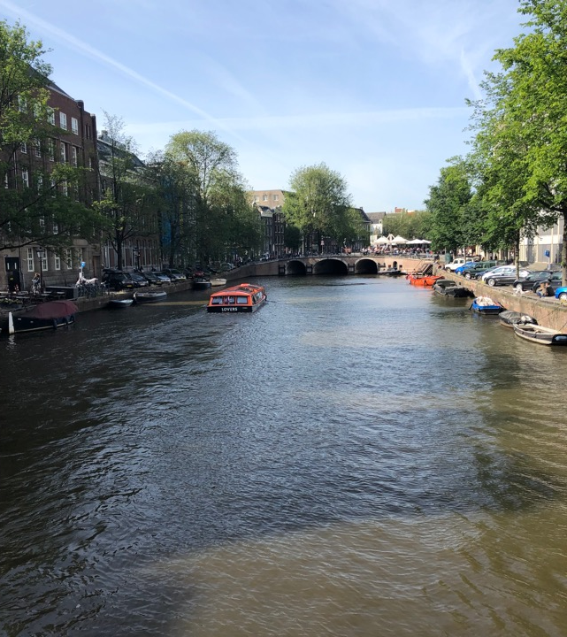
AMSTERDAM

Slide 35
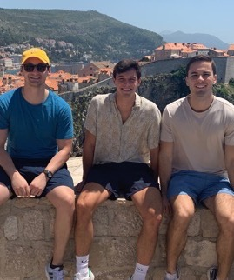
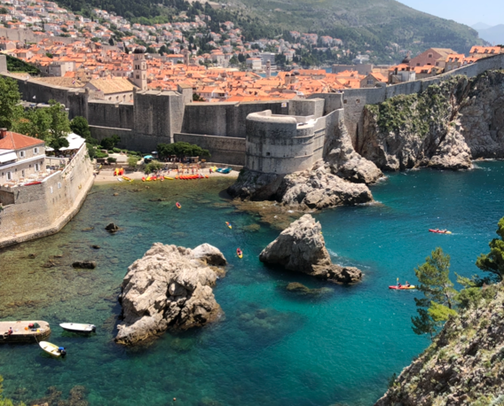
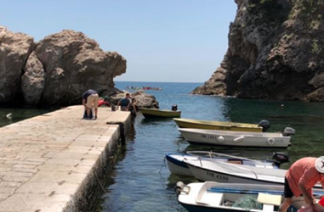
DUBROVNIK, CROATIA

Slide 36
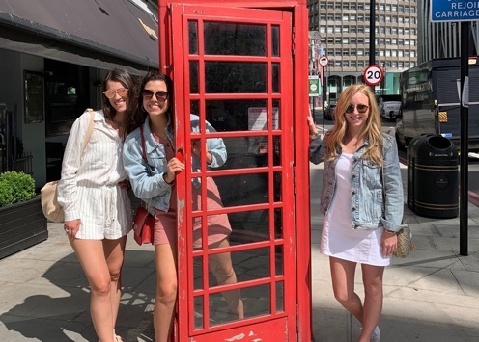
LONDON, ENGLAND

Slide 37
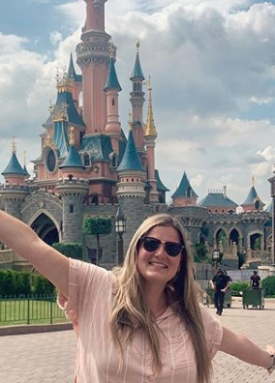
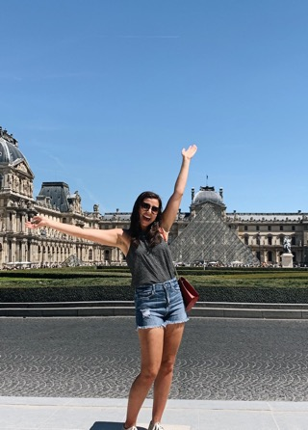
PARIS

Slide 38
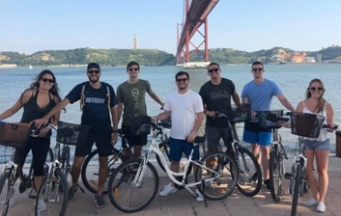
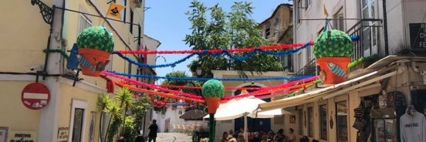
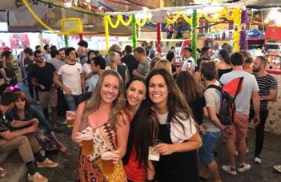
LISBON

Slide 39
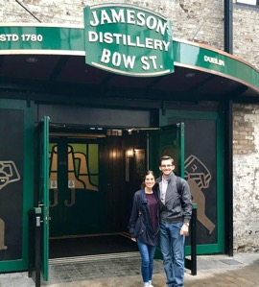
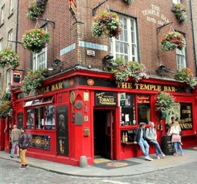
IRELAND

Slide 40
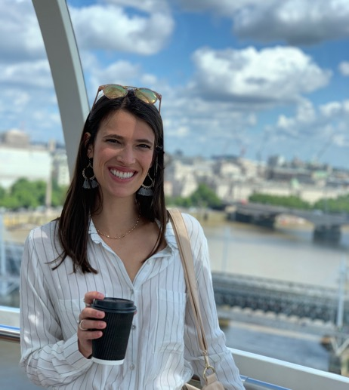
STUDENT TESTIMONIAL
“10/10 would recommend studying abroad in Lyon during law school. It was such an incredible experience and also gave me the opportunity to get credit hours out of the way. I was able to meet people from every section, which made the transition into 2L year so easy. I think every student should take advantage of this program. It has been my favorite experience of law school so far!
-Virginia Stewart

Slide 41
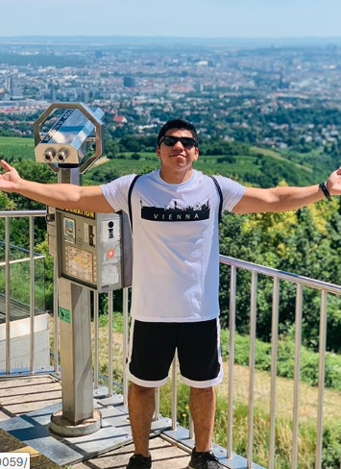
STUDENT TESTIMONIAL
“Summer in Lyon was a once in a lifetime experience. I was able to travel and explore seven different countries and enjoy the different cultures of each. I still remember the beautiful view hanging out by the river with my friends, seeing the sunset go down. Miss it so much – it was truly the best summer of my life.”
-Sam Velasquez

Slide 42
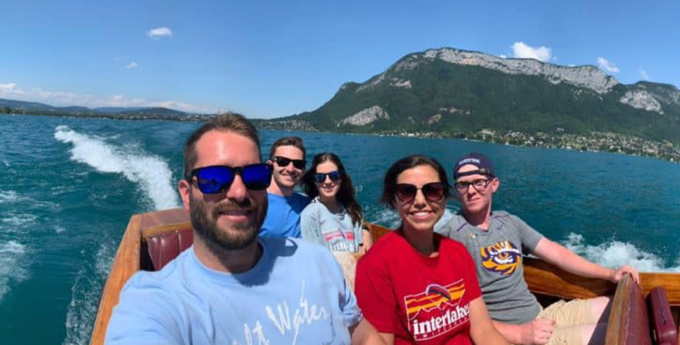
CONTACTS
Professor John Church (jchurch@lsu.edu)
Professor Randy Trahan (jrtrahan@lsu.edu)
Professor Olivier Moreteau (Olivier.Moreteau@law.lsu.edu)
Professor Wendell Holmes (Wendell.Holmes@law.lsu.edu)
STUDENT REPRESENTATIVES:
Katelyn Bayhi (kbayhi2@lsu.edu)
Kate McLean (kmclea4@lsu.edu)

